Slide 1
Population of Suriname 2004 492.829 Census Bureau 2005
Maroon
Creole
Hindoestaan (Indian)
Javanese(Indonesian)
Mixed
Others
Unknown
72.553 (‘72 -35.838)
87.202 (’72-119.009)
135.117(’72-142.917)
71.879 (’72- 57.688)
61.524
31.975 (’72-24.155)
32.579

Slide 2
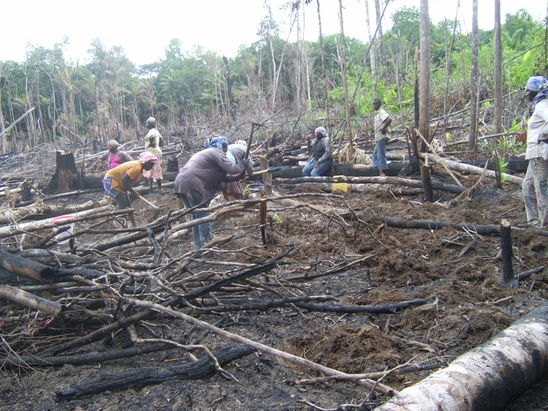
Maroon Women at work
 | Teachers
M |  | F
29 |  | 292
 | Teachers
M |  | F
29 |  | 292

Slide 3
Life in Surinamese tribal communities
Traditional Education vs Western Education

Slide 4
Tribal Leadership Peace Treaty 10 October 1760

Slide 5
Tribal governing structure
Gaaman/King
High Chief (Ede Kabiten)/Viskarie
Village Chief (male/female)
Basya (2male/2 female per chief)
Elders (male/female)

Slide 6
Female Maroon hero’s in the war against Slavery in Suriname
Ma Paansa
Ma Abenkina
Ma Kato
Ma Susanna

Slide 7
Education is the Gateway to success and development
Informal education,
networks of individual or collective interaction
Formal education, officially structured by the government within the judicial system of a country
Education provides opportunities to access knowledge and recourses, survive, sustainable development and information

Slide 8
Role of Maroon Women
Knowledge of the land
Knowledge of the culture and values
Educator (children)
Food producer
Social cooperation
Advisor
most likely based on seniority and prestige

Slide 9
Western Education in Maroon land

Slide 10
Western Education for Girls
1762 – late 1980’s – not important
education in traditional roles and ethics were more important in order to preserve African lifestyle
1990 – to date – mindset changed, more girls
in high school and university

Slide 11
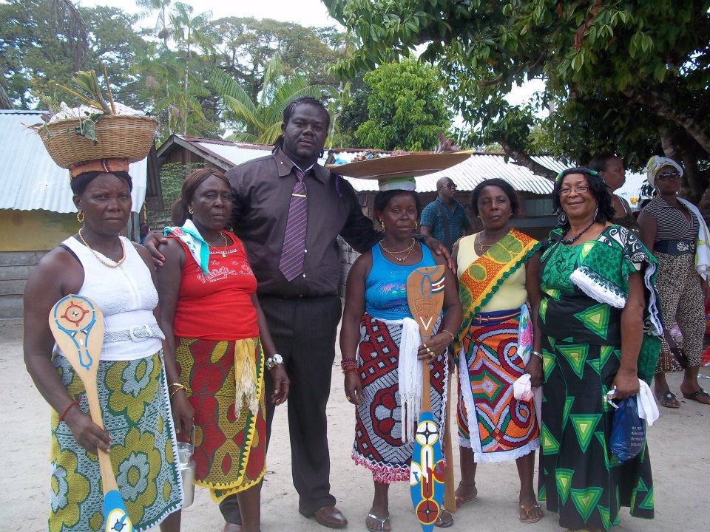
Self embroidered pangi’s(wraps)

Slide 12
The most vulnerable groups
Maroon(72.553) and Indigenous(18.037-Bureau of Statistics, 2005) population. Living in tribal communities in the rural and remote (interior) areas of Suriname.
Poor access to the most basic social- and economical infrastructure

Slide 13
The Colonial educational system of Suriname (1929 -1975 )
Policy started in 1929
- Retrenchment of provided education to the population divided in :
City
District
Interior (boslandonderwijs: dutch for bushland education)

Slide 14
Qualifications of teachers at primary school level in kolonial time(6 grades + 2 years pre-school)
City - Only graduates from the teachers college(4 years)
Districts - Graduates(from the teachers college) and teacher trainees (experienced undergraduates, 1 year training)
Interior - Only undergraduates
(training 6 months – 1 year)

Slide 15
Structural changes
1973 – unification and equalization of the formal educational system by law
(by the Minister of education- Drs R. Venetiaan)
1980’s – upgrading courses for undergraduate teacher trainees of the interior(Maroon & Amer-Indian
communities)

Slide 16
Structural changes
Mid ’80’s – domestic war and closure of schools in the interior
’90’s - renewal training of teachers 6 months to 1 year ( the students are drop-outs of the secondary school or high
School)
There were no teachers available for the interior.

Slide 17
2000-TO DATE
Gradual increase of qualified teachers in primary schools in the interior
Two nucleus secondary schools (Albina and A Tjoni
Continuous upgrading courses for unqualified teachers.

Slide 18
Development level of Maroon societies
Illiteracy level is significantly high especially in the remote villages of the interior
Lack of proper sanitation facilities
Poor access to credit facilities due to land right problems
Poor transportation facilities
High socio-economic dependency
Poor organizational facilities
Notes:
Traditional

Slide 19
Empowering Village Women

Slide 20
Stewardship of Government and NGO’s
Economic empowerment
Capacity building – Government & NGO’s
Micro entrepreneurs – agribusiness
Political empowerment
Social empowerment
Formal and informal networks
Grass Root Organizations

Slide 21
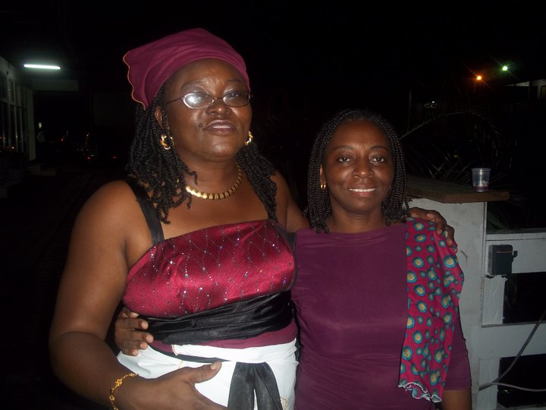

Slide 22
Challenges
Interior
Lack of title on the land (live and work on)
Traditional production infrastructure
Multi tasking of labor
High illiteracy rate
Dependency on the transportation of products from remote areas to urban areas mostly over waterways

Slide 23
Gender
Unicef & VVOB primary school mapping 2010
1st Grade and 6th grade
M 608 218
F 509 326
Political Offices
Kabinet ministers
2005-2010 Diplomats
M 2 4
F 1 2
2010 – 2015
M 5 4
F 1 2

Slide 24
Thank You
Dank U
Grantangi

